Slide 1
Bangkok Housing Price Prediction
For buyers and sellers

Slide 2
Problems
Do you ever have a problem when moving to a new home ?
Housing price in Bangkok is normally fluctuated due to many factors, some factors are considered to be positive for the price, but is that always true ?

Slide 3
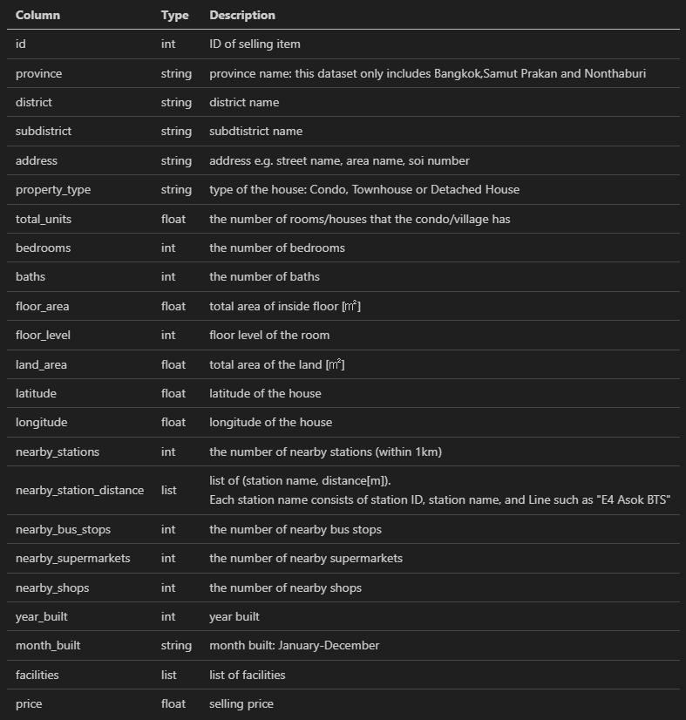
The data: Bangkok Housing Price
Notes:
The data consists of many factors that might be affect the housing price
While the price is what we want to predict

Slide 4
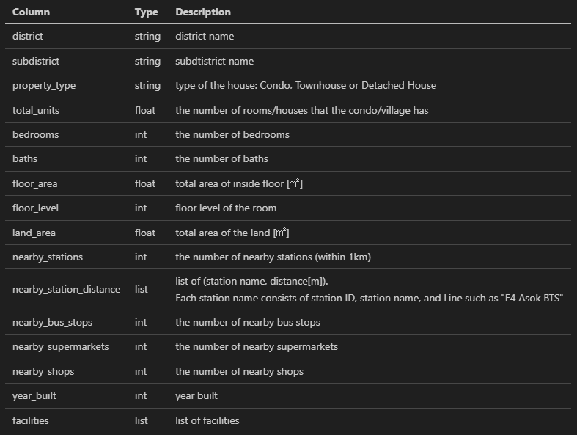
Considering the information …
Useless
Id
Month built
Address
Redundant
Province
Latitude
Longitude
Notes:
Nearby bus stops is useless because of very low correlation with price, already experiment with it and have nearly no effect to the model prediction

Slide 5
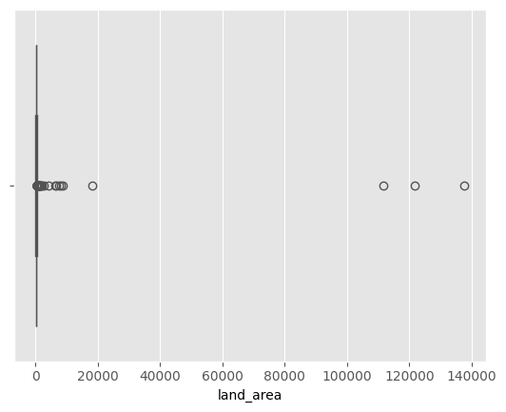
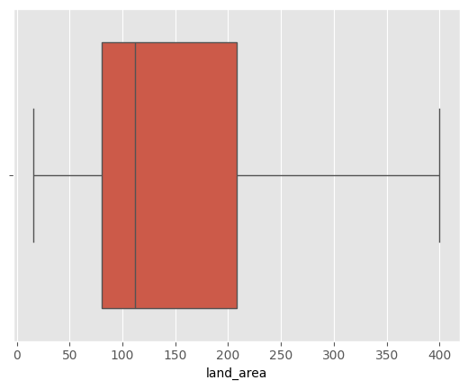
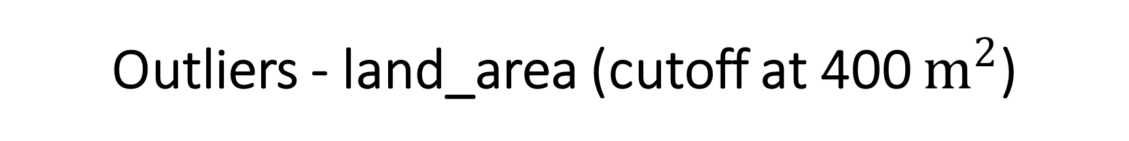
Outliers - land_area (cutoff at 400 $m^{2}$)

Slide 6
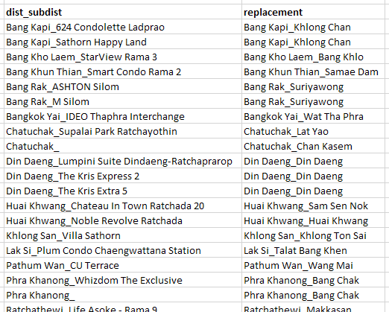
Value corrections
There are some incorrect values in subdistrict that need to be replaced.

Slide 7
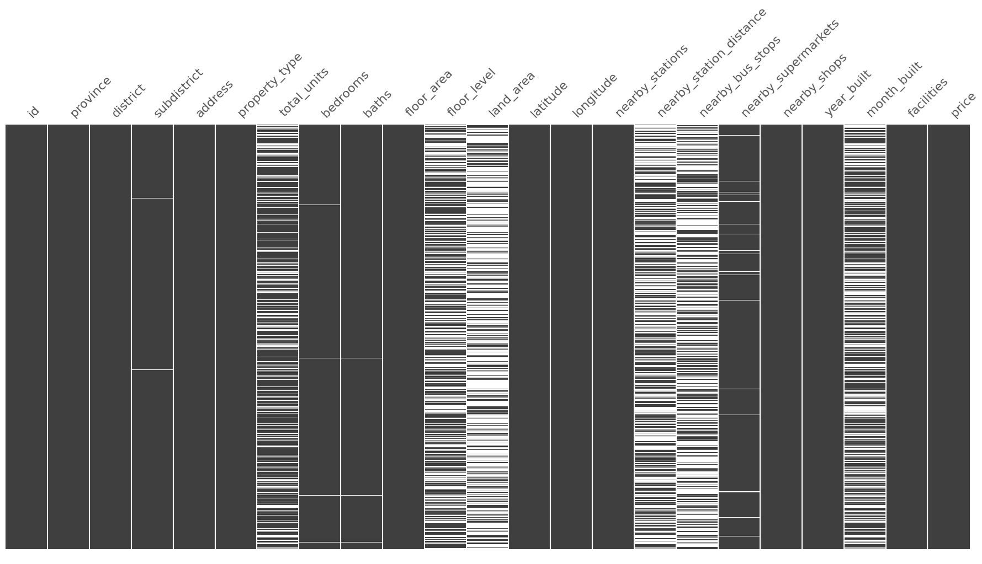
A lot of missing data
Notes:
Some column with fewer missing value, those value can be removed
Red columns are what will be used, so it’s need to be imputed
Blue need to use custom transformation, as the missing value means there is no nearby station which can be possible

Slide 8
A lot of missing data
KNN-imputed with missing indicator
* There are 0 in year_built, replace it with null and then impute
Notes:
Some column with fewer missing value, those value can be removed
Red columns are what will be used, so it’s need to be imputed
Blue need to use custom transformation, as the missing value means there is no nearby station which can be possible

Slide 9
A lot of missing data
KNN-imputed with missing indicator
Mean-imputed with missing indicator
Notes:
Some column with fewer missing value, those value can be removed
Red columns are what will be used, so it’s need to be imputed
Blue need to use custom transformation, as the missing value means there is no nearby station which can be possible

Slide 10
A lot of missing data
KNN-imputed with missing indicator
Mean-imputed with missing indicator
Custom transformation + normalization
Notes:
Some column with fewer missing value, those value can be removed
Red columns are what will be used, so it’s need to be imputed
Blue need to use custom transformation, as the missing value means there is no nearby station which can be possible

Slide 11
A lot of missing data
KNN-imputed with missing indicator
Mean-imputed with missing indicator
Custom transformation + normalization
Then, drop the rest of missing value
except “month_built” because it is not used
Notes:
Some column with fewer missing value, those value can be removed
Red columns are what will be used, so it’s need to be imputed
Blue need to use custom transformation, as the missing value means there is no nearby station which can be possible

Slide 12
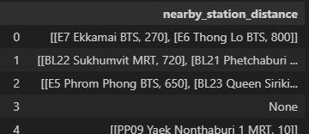
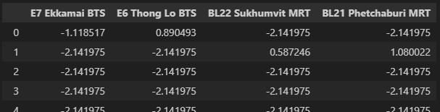
For nearby_station_distance
Custom transformation + normalization

Slide 13
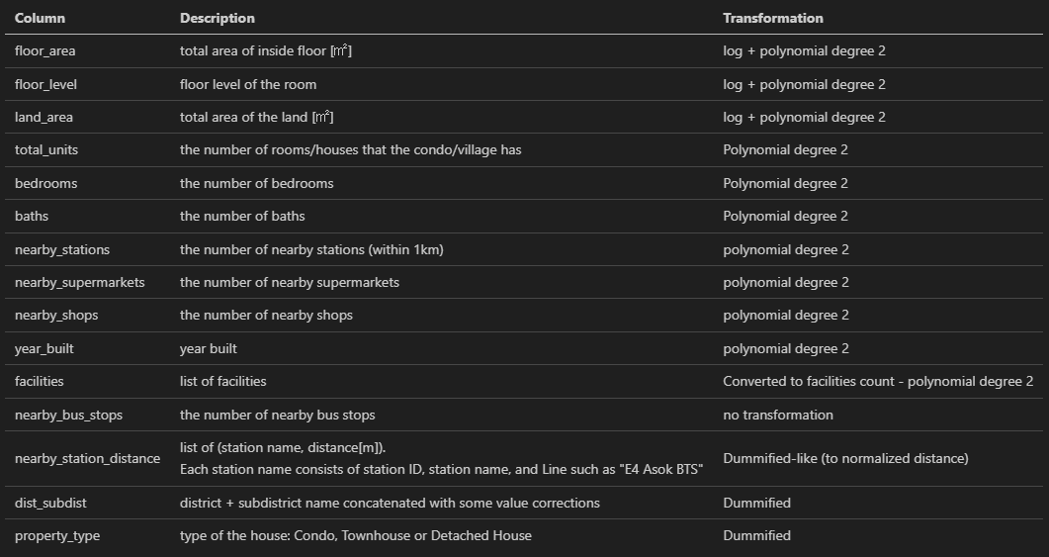
Other transformations & summary

Slide 14
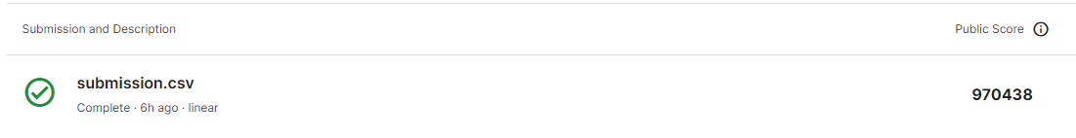
Result
Prediction model that
Can explain 79.4% of data
The average error of 945K THB approximately

Slide 15
Other findings
The following factors are significantly affect housing price positively.
Floor area
Number of nearby stations (within 1km)
Number of bathrooms
Total area of the land
Year built
Number of bedrooms
Locating neaby these stations will significantly raise the price as well.
BL11 Bang Sue MRT
BL32 Itsaraphap MRT
B9 Rama IX Bridge BRT

Slide 16
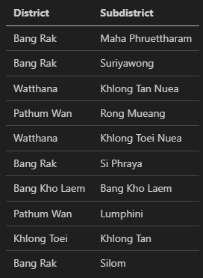
Other findings
Top 10 district/subdistrict that will have
higher housing price according to the model.

Slide 17
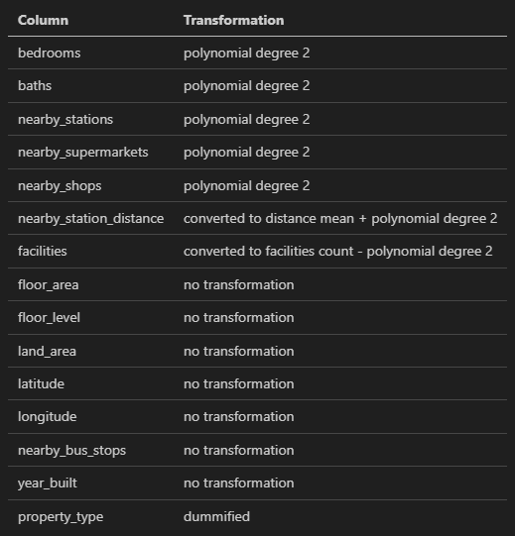
Extra
XGBoost model with ~85% score
Average error ~771K
Total of 49 features

